Slide 1
C++ Intermediate

Slide 2
Homework review

Slide 3
Time complexity

Slide 4
What is time complexity?
Time complexity are notations indicating how long your program will run in proportion to the constraints on data.
The more commonly used notations are:
~ - An approximate runtime
O() – The worse case runtime

Slide 5
Why is time complexity important?
As you get better and better at programming, you will start working with bigger data sets. The bigger the data set, the longer your code will run.
In computing competitions, there are also time limits on the runtime of your code.
Computing your time complexity can also give you insights into which solutions will work, and what direction you should work towards.

Slide 6
How to calculate time complexity?
As a benchmark to work with, C++ can do 10⁸ operations per 1 second.
An operation counts as any line of code, but we call it O(1).
Looping to a certain value N takes O(N).
We usually only take into account significant amount of operations.
Example:
O(N² +100N + 10000) = ~ N² (If N = 1000)
Since
O(10⁶ + 10⁵ + 10⁴) = ~ 10⁶

Slide 7
Examples of time complexity?
There are many other time complexities, however the most common ones that we will see are:
O(1) (constant runtime)
O(log N) (logarithmic runtime)
O(sqrt(N)) (sub-linear polynomial runtime)
O(N) (linear runtime)
O(N log N) (linearithmic, almost linear)
O(N²) (quadratic runtime)
O(N³) (cubic runtime)
O(2^{N}) (exponential runtime)

Slide 8
time complexity Exercise
What is the time complexity of:
The optimized prime finder?
Bubblesort?
Binary search?

Slide 9
recursion

Slide 10
What is recursion?
Recursion is a technique where one divides a problem into smaller subtasks.
There are 2 main characteristics for recursion (besides using a function):
We have base cases (the function must terminate with certain parameters)
The function repeatedly calls itself

Slide 11
How does that work…?
One thing important to note (I myself made this mistake), is that functions run like the main function.
When a function calls itself, it will run through itself again, but will come back where it left off!
After it calls itself and takes a result, it uses it to solve the sub-problem it is currently on and will return it eventually!

Slide 12
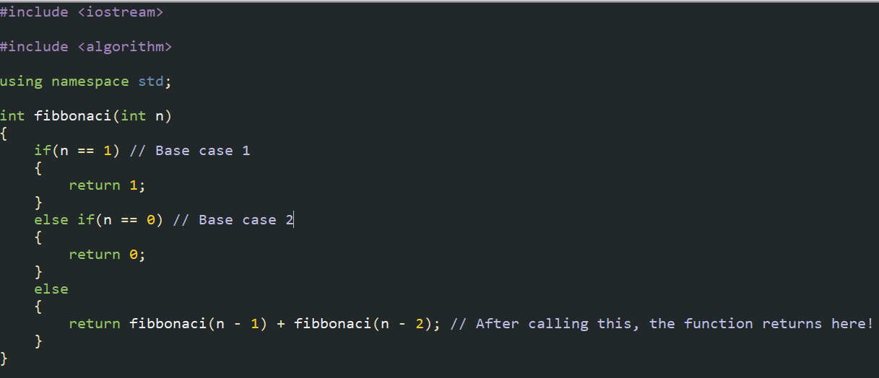
Example:

Slide 13
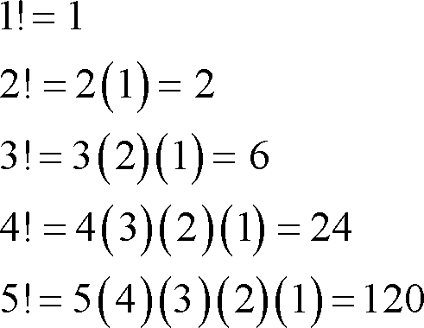
exercise 1
Given a number n, output n! (factorial).

Slide 14
Prefix sum array

Slide 15
What is a prefix sum array?
A prefix sum array (psa for short), is a clever use of an array to quickly process sums of consecutive elements in an array.
Each index of the psa will correspond to the sum of all the indices before it (in the original array).
One important thing to note is a psa is usually 1-indexed.

Slide 16
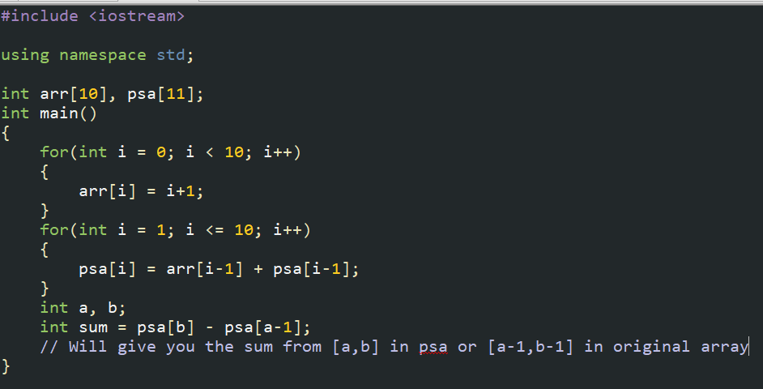
Example

Slide 17
Matrices

Slide 18
What is a Matrix?
A matrix or matrices are 2D arrays.
They are initialized very similarly to the way regular arrays are initialized and accessed similarly as well.
Each singular index will correspond to an array, but double indices will correspond to an element.

Slide 19
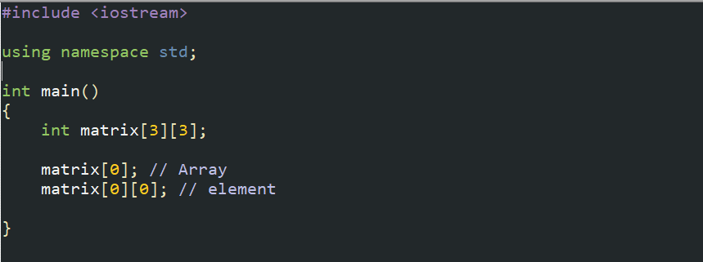
Example

Slide 20
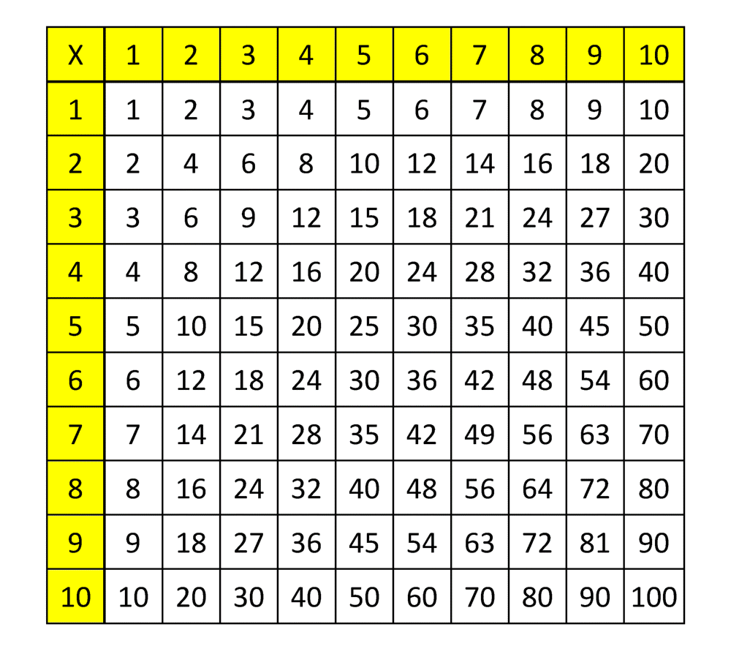
Exercise 2
Create a 10x10 matrix and fill it up like a times table!
You should print it afterwards.

Slide 21
Homework 1
Create 1 10x10 matrix that are filled horizontally than vertically with numbers from 1-100.
Create another but filled from 100-1.
Multiply the matrix!
(You should search up what matrix multiplication is, but not the code)

Slide 22
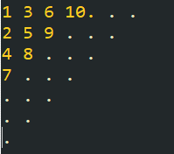
Homework 2
Fill a 10x10 matrix with numbers from 1-100 diagonally.
Should look like this:

Slide 23
Homework 3
Given an integer n and integer k as input, print out all binary numbers of length n with k 1s.
(Note that you should probably use strings)

Slide 24
Homework 4
Fill an array with the first 100 prime numbers.
How many prime numbers can be written as a consecutive sum of any of the first 100 prime numbers?
Ex.
2+3 = 5
5+7+11 = 23

